Slide 1
Chapter4 Discrete-time Systems
1
Classification of Discrete Systems
2
Impulse and Step Response
3
LTI Discrete-time Systems
4
Frequency-Domain of LTI DTS
5
Phase and Group Delay
Notes:
1

Slide 2
4.1 Discrete-Time Systems Examples
A discrete-time system processes a given input sequence x[n] to generates an output sequence y[n] with more desirable properties.
In most applications, the discrete-time system is a single-input, single-output system:
Discrete-Time
System
x[n]
y[n]=H(x[n])
Input sequence
Output sequence
MOOC

Slide 3
4.1 Discrete-Time Systems Examples
Accumulator
In another form
MOOC

Slide 4
4.1 Discrete-Time Systems Examples
Moving-Average filter
Exponentially Weighted Running Average filter
MOOC

Slide 5
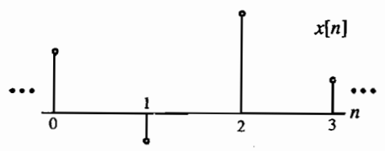
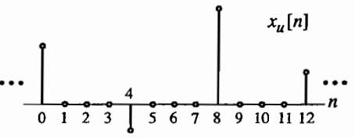
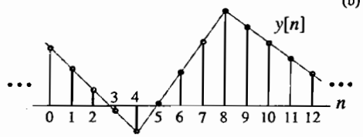
4.1 Discrete-Time Systems Examples
Linear Interpolator

Slide 6
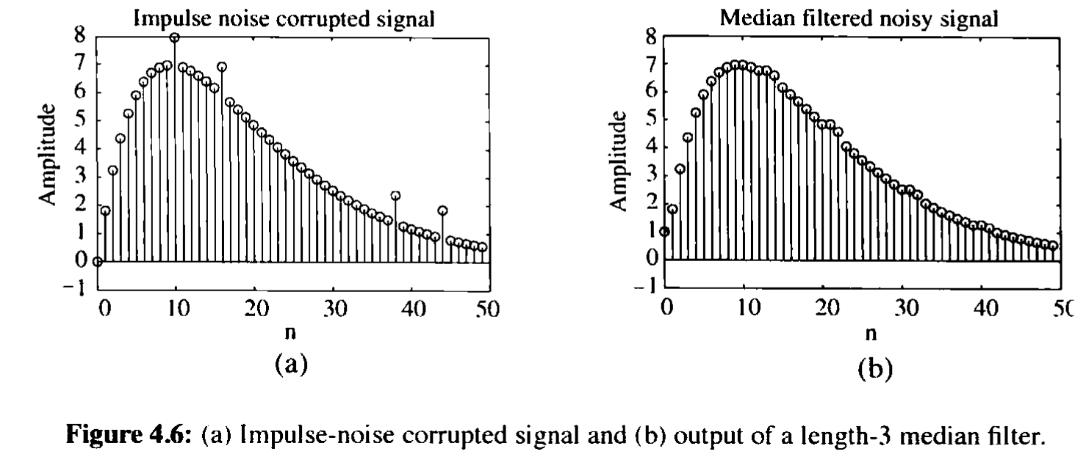
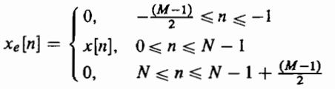

4.1 Discrete-Time Systems Examples
Median filter

Slide 7
4.2 Classification of Discrete-Time Systems
Linear System
Shift-Invariant System
Causal System
Stable System
Passive and Lossless Systems

Slide 8
4.2 Classification of Discrete-Time Systems
Linear System
Definition：
For an input signal
The response is given by
If superposition property hold for any arbitrary constants, α and β, and for all possible input signals, the system can be called as linear system.
MOOC

Slide 9
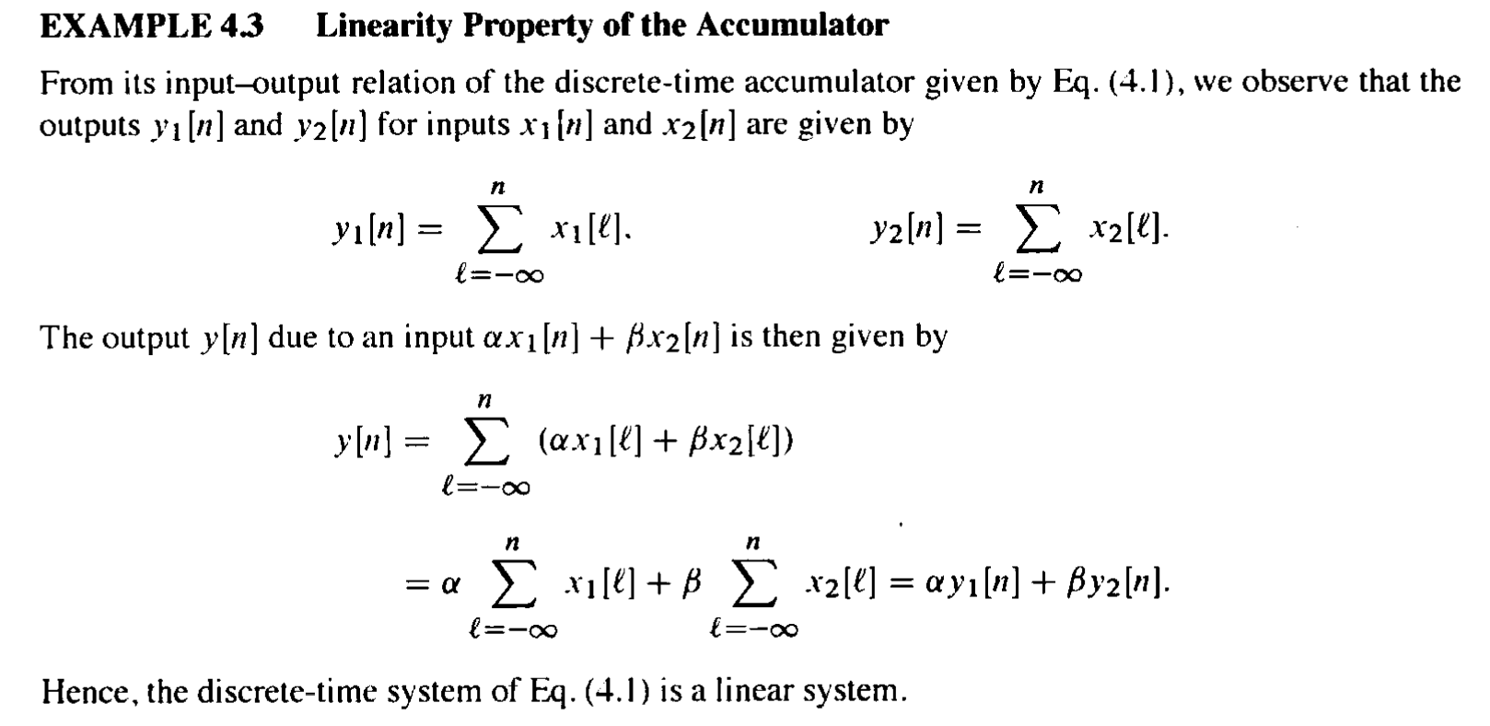
4.2 Classification of Discrete-Time Systems
Notes:
Note：For nonzero initial conditions, the discrete time system is nonlinear.

Slide 10
4.2 Classification of Discrete-Time Systems
Shift-Invariant System
Definition
For an input signal
The response is given by
If for any n₀ can be given,
the system is called as shift-invariant system.
MOOC

Slide 11
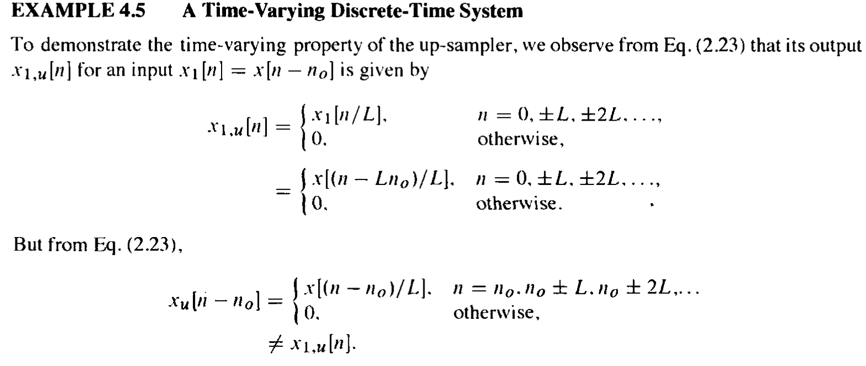
4.2 Classification of Discrete-Time Systems

Slide 12

4.2 Classification of Discrete-Time Systems
Causal System
Definition :
The n₀th output sample y[n₀] depends only on input samples x[n] for n ≤n₀ and does not depend on input samples for n＞n₀
For a causal system, the response to x[n] is y[n].
If for n＜N
Implies also that for n＜N
$$x_{1}[n]=x_{2}[n]$$
only to discrete-time systems with the same sampling rate for the input and the output.
MOOC

Slide 13
4.2 Classification of Discrete-Time Systems
Stable Sytem
Definition: If and only if, for every bounded input, the output is also bounded, the system can be called as stable system.
This type of stability is usually referred to as bounded-input, bounded-output (BIBO) staility.
For a BIBO system, the response to x[n] is y[n].
While |x[n]|＜B_{x},for all values of n
Then: |y[n]|＜B_{y.} for all values of n
where B_{x} and B_{y} are finite constants.
MOOC

Slide 14
4.2 Classification of Discrete-Time Systems
Passive and Lossless system
Definition: A discrete-time system is said to be passive if, for every finite energy input sequence x[n], the output sequence y[n] has, at most, the same energy, i.e.
If the above inequality is satisfied with an equal sign for every input sequence, the discrete-time system is said to be lossless.

Slide 15
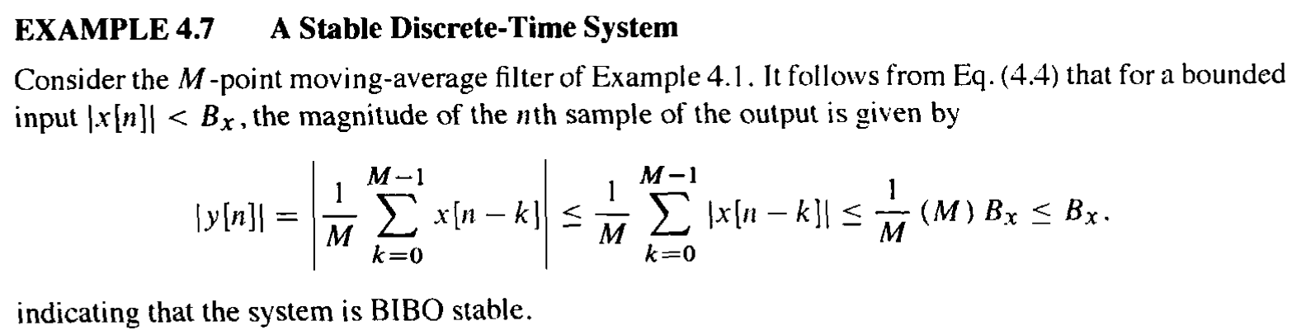
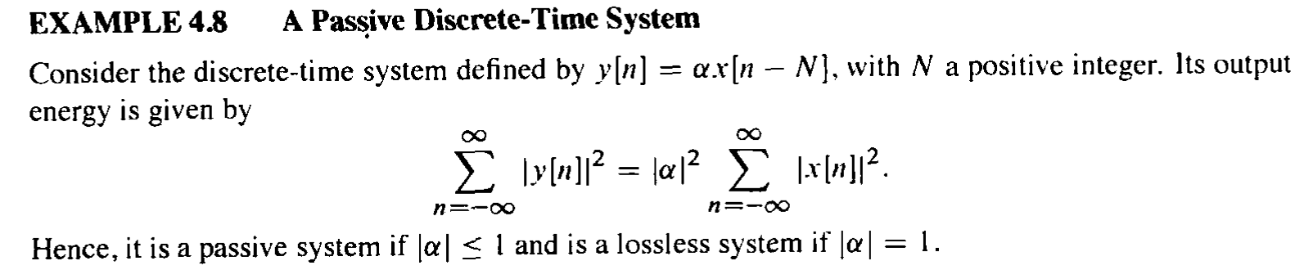
4.2 Classification of Discrete-Time Systems

Slide 16
4.3 Impulse and Step Responses
Definition:
The response of a digital system to a unit sample sequence {δ[n]} is called the unit sample response, or simply, the impulse response, and is denoted as {h[n]}.
The response of a discrete-time system to a unit step sequence {μ[n]}, denoted as {s[n]}, is its unit step response or simply, the step response.
A linear time-invariant digital system can be completely characterized in the time-domain by its impulse response or its step response.
★

Slide 17
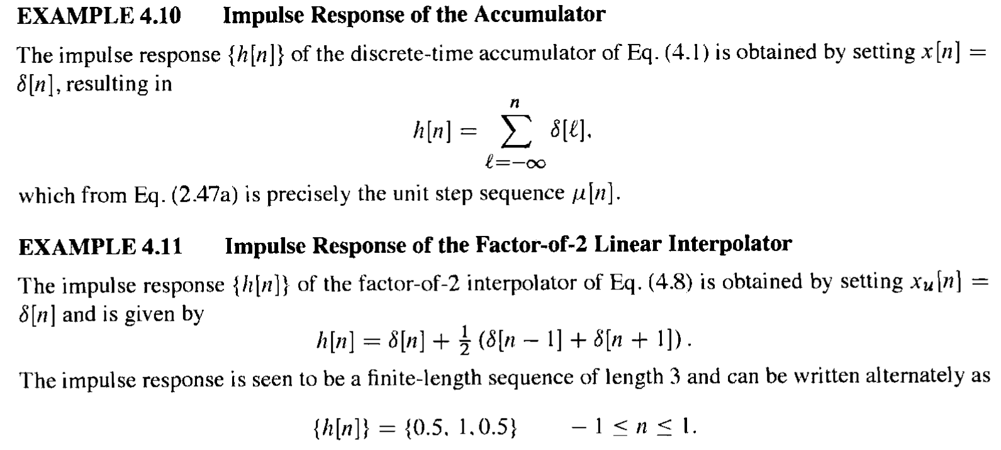
4.3 Impulse and Step Responses

Slide 18
4.4 Time-Domain Characterization of LTI DTS
4.4.1 Input-Output Relationship
Because
The response of the LTI system to an input x[k]δ[n-k] will be x[k]h[n-k]
So，
y[n] = x[n] h[n]
*
MOOC

Slide 19

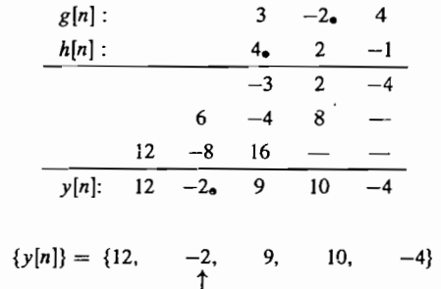
4.4 Time-Domain Characterization of LTI DTS
4.4.2 Convolution Sum Computation

Slide 20
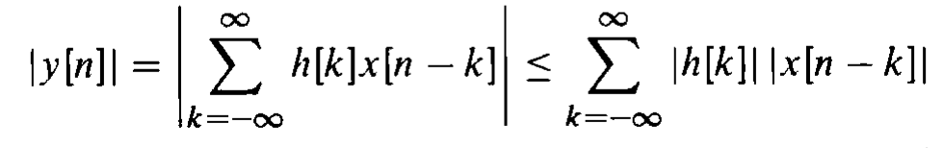
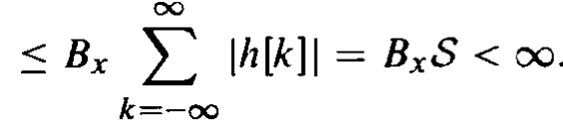
4.4 Time-Domain Characterization of LTI DTS
4.4.3 Stability System Condition
If and only if the output sequence y[n] of the system remains bounded for all bounded input sequence x[n], a LTI discrete-time is defined to be BIBO stable

Slide 21
Example: consider a LTI system shown as below:
For this system
So, if , above system is BIBO stable. otherwise, the system is not BIBO stable.

Slide 22
4.4 Time-Domain Characterization of LTI DTS
4.4.4 Causality System Condition
If and only if the response sequence {h[n]} of a LTI discrete-Time system is satisfying the condition of equation below, it is causal:
h[k]=0, for k<0
Causality & Stability System Condition
MOOC

Slide 23
4.5 Simple Interconnection Schemes
1. Cascade connection
Definition: If the second LTI systems’ input is connected to the first systems’ output, we say the two system are connected in cascade. The overall impulse response h[n] of the two cascaded-systems is given below:
*

Slide 24
4.5 Simple Interconnection Schemes
2.Parallel connection
Definition: If the two LTI systems’ output are added to form the new output while the same input is fed to both system, we say the two system are connected in parallel. The overall impulse response h[n] is given below:

Slide 25
Example:
Consider the following discrete-time system:
h₁[n]= δ[n] + 0.5δ[n-1]
h₂[n]= 0.5δ[n] - 0.25δ[n-1]
h₃[n]= 2δ[n]
h₄[n]= 2(0.5)^{n}μ[n]

Slide 26
Simplifying the block-diagram
*
h₁[n]+
*
h₁[n]+
h₂[n] h₃[n] + h₂[n] h₄[n]
*
*

Slide 27

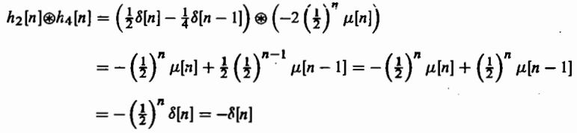


Slide 28
4.6 Finite-dimensional LTI discrete-time system
Definition:If for the LTI system, the relation between input x[n] and output y[n] is given as below:
Here, d_{k}, p_{k} are constant. The order of the system is given by max(N,M).
If we assume the system to be causal and
MOOC

Slide 29
To solve L.D.E. in Sequence Domain:
Iteration -- we must know initial condition of y[n], and different initial condition will cause different result.
Example:
y(n) - ay(n-1) = x(n), Let x(n) =
If initial conditions: …=y(-2)=y(-1)=0,
h(n) = a^{n}u(n) ---causal
If initial condition: y(n)=0, n≥0
h(n) = -a^{n}u(-n-1) ---non-causal

Slide 30
4.6 Finite-dimensional LTI discrete-time system
4.6.1 Total solution calculation
We may divided the answer of Eq(4.32) into two parts as below:
Here ,y[n] is called total solution .
y_{c}[n] is the solution of Eq(4.32) with the input ,which is called complementary solution.
y_{p}[n] is the solution of Eq(4.32) with the specified input , which is called particular solution.

Slide 31

4.6.1 Total solution calculation
1）N个特征根都不相同：
2）N个特征根有k次重根：
3）N个特征根中有共轭根：
LTI系统，输入与输出形式相同，
特解与x[n]的形式一样，可用待定系数求解。

Slide 32
4.6 Finite-dimensional LTI discrete-time system
4.6.2 Zero-input response and zero-state response
We may also divided the answer of Eq(4.32) into the two parts as below:
zero-input response y_{Zi}[n]
zero-state response y_{Zs}[n]

Slide 33
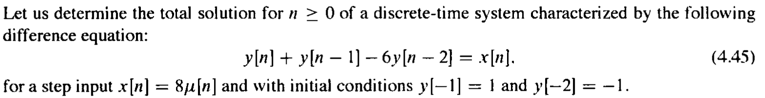
Example 4.22
First，determine the eigen values：

Slide 34

Complementary solution:
Particular solution for
$$x[n]=8μ[n]$$
$$β+β−6β=8μ[n]⇒β=−2\begin{matrix} & n≥0\end{matrix}$$
Total solution of the form:

Slide 35
Determine the constants to satisfy the specified initial conditions：
So:
Total solution is:

Slide 36
Example 4.24
Determine the total solution of the Ex4.22 by computing the Zero-input response and zero-state response.
Zero-input response:
Notes:
零输入响应就是齐次解形式，将初始条件代入即可求出

Slide 37

Determine the constants to satisfy the zero initial conditions：
Zero-state response:
Total solution is:

Slide 38
4.6.3 Impulse response calculation
The impulse response h[n] of a causal LTI system is the output with input x[n]=δ[n].
Example 4.25: Impulse response of the Ex4.22.
We get：

Slide 39
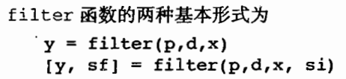
Using MATLAB
% Program 4_4
b = [-6.76195 13.456335 -6.76195];
% Set initial conditions to zero values
zi = [0 0];
% Generate the two sinusoidal sequences
n = 0:99;
x1 = cos(0.1*n);
x2 = cos(0.4*n);
% Generate the filter output sequence
y = filter(b, 1, x1+x2, zi);
Notes:
The causal LTI system can be simulated in MATLAB using the function filter.

Slide 40
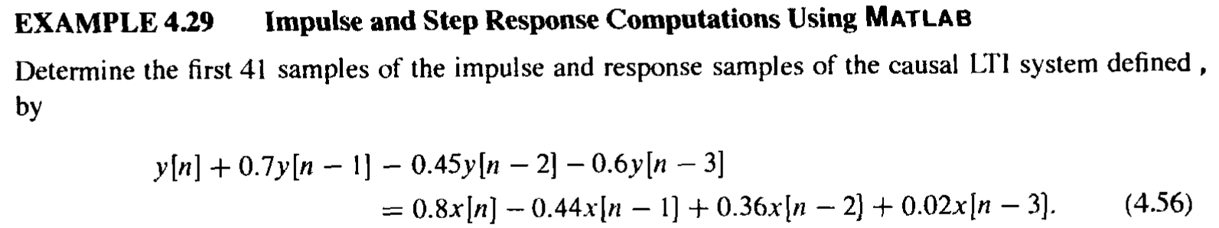
Using MATLAB
The impulse and step response of a causal LTI discrete-time system can be computed using the MATLAB fuctions impz and stepz.
p=[0.8 -0.44 0.36 0.02];
d=[1 0.7 -0.45 -0.6];
[h,m] = impz(p,d,41);
[s,m] = stepz(p,d,41);

